Slide 1
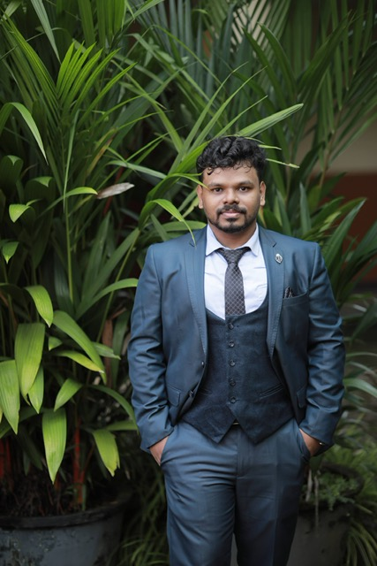
Consultant business analyst - Az SERVICES: Noufal Salim
Main Areas of Expertise
Consultant – Business Analytics
Technical skills:
Python, REST API, SQL, Foundry, Excel, Dagster/data orchestration
AI-ML, Data Analysis, Visualization, modeling, Chatbot
Recent Projects
+91-8129585152
Noufal.salim@allianz.com
AZ SE: Mapped UK vehicle data with German Vehicle data using statistical methods and confirmed the accuracy manually
AGCS: Developed a random forest ensemble classification model for the prediction of the outcome of quality checks to improve the overall process quality for the AGCS team.
AZ RE: Responsible for driving the activities within the NatCat Data Support team that supports AZ Re, Munich. Activities include NatCat Modelling, Data preparation for ASPIRE submissions, and Data Quality Scoring reports using tools MicroStrategy and Excel
AZ S Finance: Tool Development for Finance teams- Leveraged text mining techniques to extract reference numbers and later tag the cash movements (receivables-payables) to each reference number.
PoC: Created an NLP(entity recognition) tool to extract data from resumes to identify different key points and extract the fields to automate the process of registration for a job portal.
PoC: Working on a research project to create an outlook add-in to process the attachment in a mail and respond to the sender with the appropriate predefined template.
Professional Background
Noufal Salim is a skilled data analyst who can translate business needs into technical solutions. He has 5 years of experience as an Applied machine learning developer and Data Analyst with relevant experience in statistical tools and strong programming skills in Python, SQL, and REST API. He has expertise in dashboarding, NLP and chatbot using open-source frameworks and packages.
Qualification:
M.Tech in Technology Management

